Slide 1
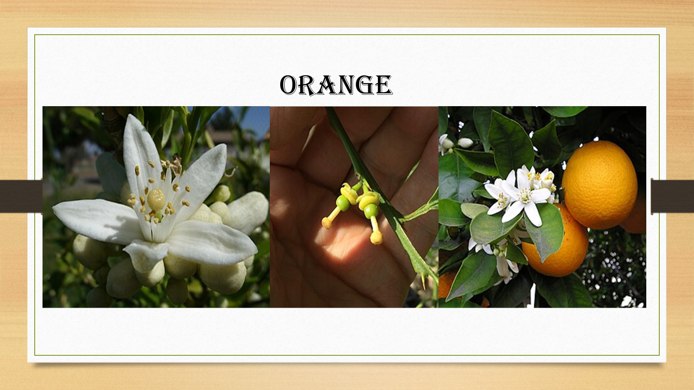

Slide 2
Common Name : Sweet Orange
Scientific Name : Citrus
Family : Rutaceae
Habit : It is a flowering tree and its height in maturity can range between 16 and 50 ft. (between 5 and 15 m). Orange tree is grown mostly for its fruits, but also for its flowers and as an ornamental.
Distribution : The orange originated in a region compassing
Southern China, Northeast India, and Myanmar

Slide 3
Description :
The orange tree is a relatively small evergreen, flowering tree, with an average height of 9 to 10 m (30 to 33 ft). The orange contains a number of distinct carpels (segments or pigs, botanically the fruits) inside, typically about ten, each delimited by a membrane and containing many juice-filled vesicles and usually a few pips. When unripe, the fruit is green. The grainy irregular rind of the ripe fruit can range from bright orange to yellow-orange, but frequently retains green patches or, under warm climate conditions, remains entirely green. Like all other citrus fruits, the sweet orange is non-climacteric, not ripening off the tree.

Slide 4
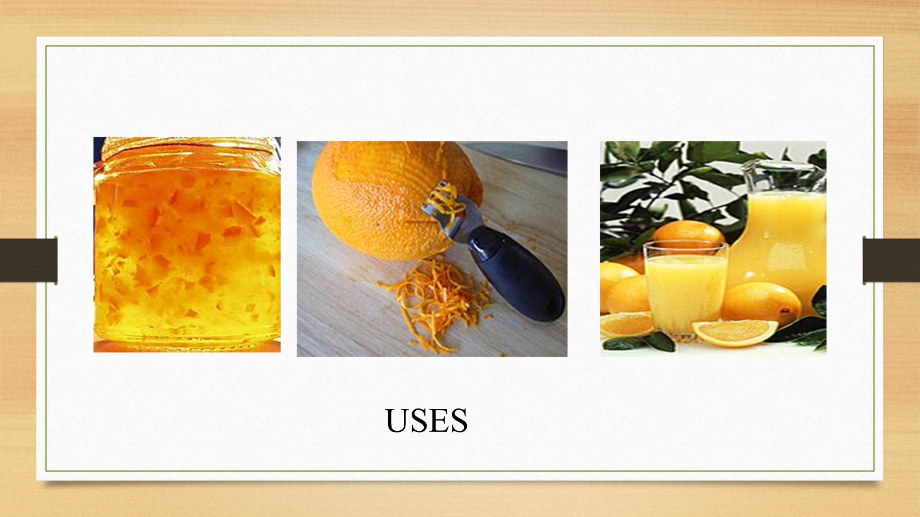

Slide 5
USES :
Aiding with digestion. The fiber content of oranges can help reduce belly fat or visceral fat.
Helping regulate blood sugar and insulin levels.
Keeping your bowel movements regular.
Satiating your appetite for long periods.
The vitamin C content in oranges helps the body absorb iron.
Oranges pack flavonoids, which have antioxidant, anti-inflammatory, antiviral, and antimicrobial properties.
Oranges supply small amounts of calcium and magnesium.
In addition to vitamin C and fiber, oranges contain potassium and folate, two vital nutrients like calcium and magnesium.

